Slide 1
Router Redundancy
In order to support redundancy on a network, multiple router can be configured to act as a single router.
  First Hop Redundancy Protocol (FHRP)
Three main options:
Hot Standby Routing Protocol (HSRP)
Virtual Router Redundancy Protocol (VRRP)
Gateway Load Balancing Protocol (GLBP)
ICND2 6-<number>

Slide 2
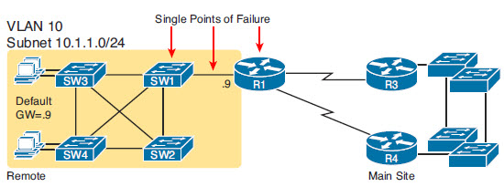
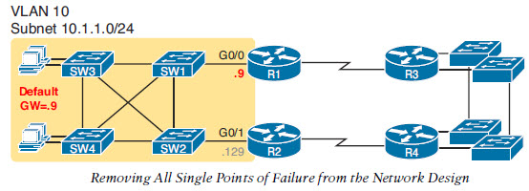
First Hop Redundancy Protocol (FHRP) Concepts
When two or more Routers connect to a LAN Subnet
FHRP provides a method for hosts on the LAN to take advantage of redundant routers
Redundancy reduces Single Points of Failure
ICND2 6-<number>

Slide 3
Dealing with Redundancy
All hosts in the subnet use R1 (10.1.1.9) as their default router, and they statically reconfigure their default router setting to R2’s 10.1.129 if R1 fails.
All hosts in the subnet use R2 (10.1.1.129) as their default router, and they statically reconfigure their default router setting to R1’s 10.1.1.9 if R2 fails.
Half the hosts use R1, and half use R2, as default router, and if either router fails, that half of the users statically reconfigure their default router setting.
These require user action
ICND2 6-<number>

Slide 4

Dealing with Redundancy
FHRP let the routers do the work
Generally FHRP does the following:
  1. All hosts act like they always have, with one default router setting that never has to change.
  2. The default routers share a virtual IP address in the subnet, defined by the FHRP.
  3. Hosts use the FHRP virtual IP address as their default router address.
  4. The routers exchange FHRP protocol messages, so that both agree as to which router does what work at any point in time.
  5. When a router fails, or has some other problem, the routers use the FHRP to choose which router takes over responsibilities from the failed router.
ICND2 6-<number>

Slide 5

First Hop Redundancy Protocols
Acronym | Full Name | Origin | Redundancy Approach | Load Balancing
HSRP | Hot Standby Router Protocol | Cisco | Active/Standby | Per Subnet
VRRP | Virtual Router Redundancy Protocol | IETF | Active/Standby | Per Subnet
GLBP | Gateway Load Balancing Protocol | Cisco | Active/Active | Per Subnet
ICND2 6-<number>

Slide 6
HSRP
Two or More routers cooperate to be the default router
  Only one router supports end user traffic at once
  Other routers are in standby state
Uses a virtual IP address and virtual MAC address
  Must be on same subnet as actual IP address
ICND2 6-<number>

Slide 7
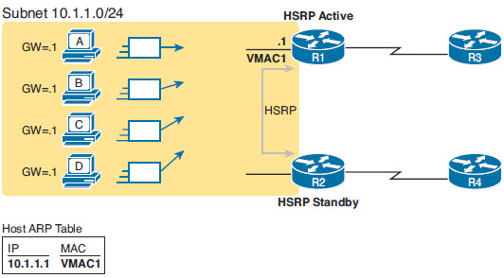
HSRP
Hosts see 10.1.1.1 /24 as Default Router
ICND2 6-<number>

Slide 8
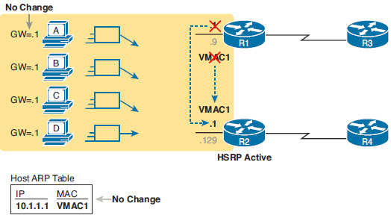
HSRP Failover
When R1 fails, no need to change
Virtual IP and MAC now refer to R2
Hosts see 10.1.1.1 /24 as Default Router
R2 sends an Ethernet frame with VMAC1 as the source MAC address.
ICND2 6-<number>

Slide 9
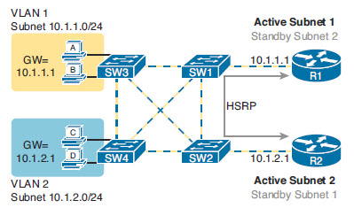
HSRP Load Balancing
HSRP supports load balancing across subnets
  Different routers can be preferred for a subnet
ICND2 6-<number>

Slide 10
Gateway Load Balancing (GLBP)
Cisco developed
Active/active- live load balancing
Hosts still configure normally
  Virtual IP addresss
Arp replies to balance
One router is Active Virtual Gateway (AVG)
  This router replies to ARP requests
  Varies the MAC address it uses
ICND2 6-<number>

Slide 11
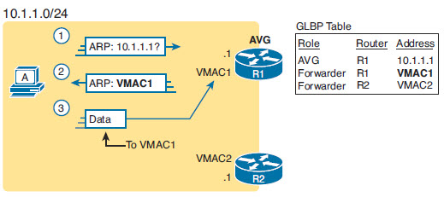
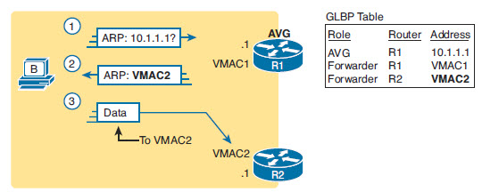
GLBP
Routers load balance
R1 responds to Host A ARP with R1 VMAC
R1 responds to Host B ARP with R2 VMAC
Still pay attention to GLBP messages in case they need to take over for a failed router
  Respond to the other Routers VMAC
ICND2 6-<number>

Slide 12
HSRP Configuration
standby group ip virtual-ip
  Group ID must match on both routers
  Virtual IP matches and is used for host default router
  R1# show running-config
  ! Lines omitted for brevity
  interface GigabitEthernet0/0
  ip address 10.1.1.9 255.255.255.0
  standby version 2 HSRP Version 2
  standby 1 ip 10.1.1.1 IP Address of default gateway
  standby 1 priority 110 Higher Priority becomes ACTIVE at failover
  Standby 1 preempt if your priority is higher, take over for ACTIVE
  Standby 1 track serial 0 Lower your priority if serial 0 goes down
  standby 1 name HSRP-group-for-book (default is 100)
ICND2 6-<number>

Slide 13
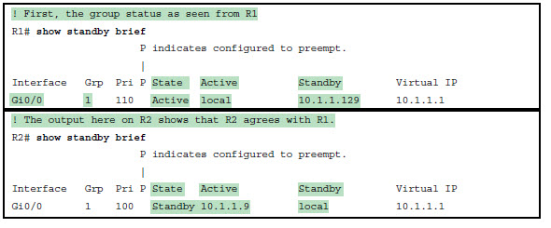
HSRP Verifications
Show standby brief
ICND2 6-<number>

Slide 14
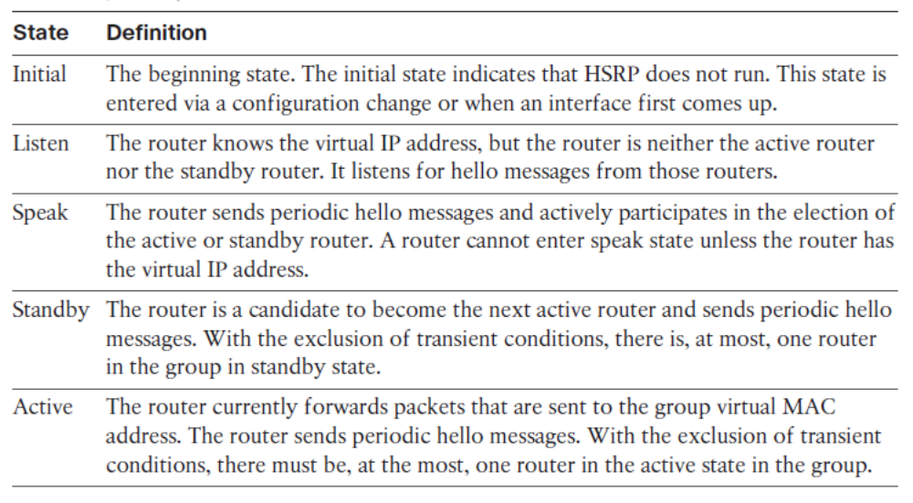

HSRP State Transition
Notes:
A router in an HSRP group can be in one of these states: initial, listen, speak, standby, or active. When a router exists in one of these states, it performs the actions required for that state. Not all HSRP routers in the group will transition through all states. For example, if there are three routers in the HSRP group, the router that is not the standby or active router will remain in the listen state.
All routers begin in the initial state. This is the starting state, and it indicates that HSRP is not running. This state is entered via configuration change, such as when HSRP is disabled on an interface, or when an HSRP-enabled interface is first brought up (for instance, when the no shutdown command is issued).
The purpose of the listen state is to determine whether there are any active or standby routers already present in the group. In the speak state, the routers are actively participating in the election of the active router, standby router, or both.
Each router uses three timers for the HSRP hello messages. When a timer expires, the router transitions to a new HSRP state.
In the example shown in Figure 6-5 , router A starts. Because it is the first router in the subnet that is configured for standby group 1, it transits through the listen and speak states, and then becomes the active router. Router B starts after router A. While router B is in the listen state, router A is already assuming the standby and then the active role. Because there is an active router already present, router B assumes the standby role.

Slide 15
HSRP Verifications
Show standby brief
Interface: The local router’s interface on which the HSRP group is configured
Grp: The HSRP group number
Pri: The local router’s HSRP priority
State: The local router’s current HSRP state
Active: The interface IP address of the currently-active HSRP router (or “local” if the local router is HSRP active)
Standby: The interface IP address of the currently-standby HSRP router (or “local” if the local router is HSRP standby)
Virtual IP: The virtual IP address defined by this group
ICND2 6-<number>

Slide 16
HSRP Verifications
R1# show standby
GigabitEthernet0/0 - Group 1 (version 2)
State is Active
6 state changes, last state change 00:12:53
Virtual IP address is 10.1.1.1
Active virtual MAC address is 0000.0c9f.f001
Local virtual MAC address is 0000.0c9f.f001 (v2 default)
Hello time 3 sec, hold time 10 sec
Next hello sent in 1.696 secs
Preemption disabled
Active router is local
Standby router is 10.1.1.129, priority 100 (expires in 8.096 sec)
Priority 110 (configured 110)
Group name is "HSRP-group-for-book" (cfgd)
ICND2 6-<number>

Slide 17
HSRP Details
Hello Messages
  224.0.0.2 (all routers) for version 1
  224.0.0.102 for version 2
Virtual MAC Address
  0000.0c07.acXX version 1 (xx is group #)
  0000.0c9f.f001 version 2
    Can also specify
Can use authentication
Tracking will lower the priority of an HSRP member
ICND2 6-<number>

Slide 18
HSRP Versions
There are two HSRP versions available on most Cisco routers and Layer 3 switches:
  HSRPv1 and HSRPv2.
Version 1 is a default version on Cisco IOS devices.
HSRPv2 allows group numbers up to 4095, thus allowing you to use VLAN number as the group number.
HSRP Version 2 must be enabled on an interface before HSRP IPv6 can be configured.
HSRP Version 2 will not interoperate with HSRP Version 1.
All devices in an HSRP group must have the same version configured; otherwise, the hello messages are not understood.

Slide 19
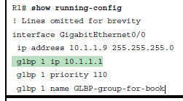
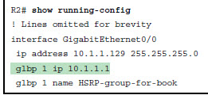
Configure and Verify GLBP
glbp group ip virtual-ip
  Group ID must match on both routers
  Virtual IP matches and is used for host default router
  Higher priority is AVG (default is 100)
ICND2 6-<number>

Slide 20
GLBP verification
R1# show glbp brief
Interface Grp Fwd Pri State Address Active router Standby router
Gi0/0 1 - 110 Active 10.1.1.1 local 10.1.1.129
Gi0/0 1 1 - Listen 0007.b400.010110.1.1.129 -
Gi0/0 1 2 - Active 0007.b400.0102 local
Fwd is -: This line refers to none of the forwarders, and instead describes the AVG.
Fwd is 1: This line describes GLBP forwarder (router) 1.
Fwd is 2: This line describes GLBP forwarder (router) 2.
AVG: One router should be the active AVG, with the other acting as standby, ready to take over the AVG role if the AVG fails.
Each forwarder: One router should be active, while the other should be listening, ready to take over that virtual MAC address if that forwarder fails.
ICND2 6-<number>

Slide 21
GLBP
R1# show glbp
GigabitEthernet0/0 - Group 1
State is Active
2 state changes, last state change 00:20:59
Virtual IP address is 10.1.1.1
Hello time 3 sec, hold time 10 sec
Next hello sent in 2.112 secs
Redirect time 600 sec, forwarder timeout 14400 sec
Preemption disabled
Active is local
Standby is 10.1.1.129, priority 100 (expires in 8.256 sec)
Priority 110 (configured)
Weighting 100 (default 100), thresholds: lower 1, upper 100
Load balancing: round-robin
IP redundancy name is "GLBP-group-for-book"
Group members:
0200.0101.0101 (10.1.1.9) local
ICND2 6-<number>

Slide 22
GLBP Details
  Hello timers are 3 seconds to 224.0.0.102
Hold timers are 10 seconds
Virtual MAC Address
  0007.b400.0101
  Up to 4 Virtual Forwarders per group
Can use authentication (including MD5)
Tracking will lower the priority of a member if the object or interface being tracked cannot be reached
ICND2 6-<number>

Slide 23
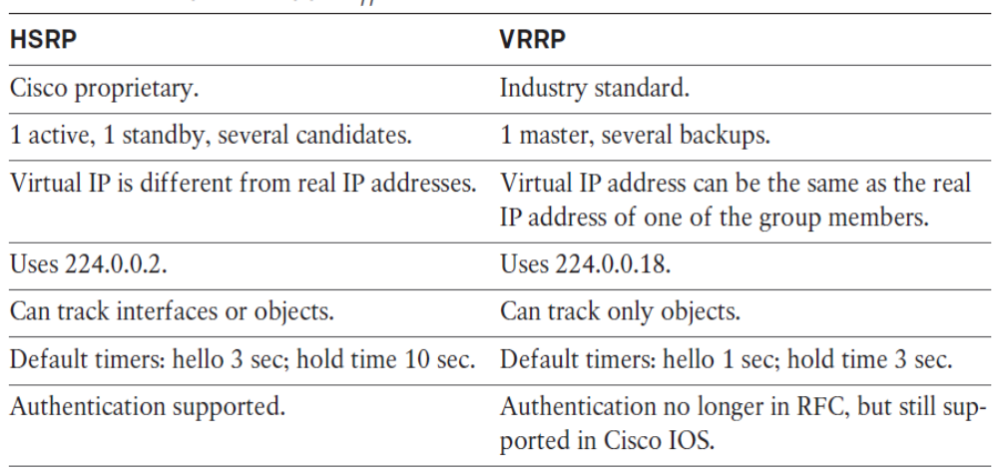
HSRP and VRRP Differences

